Slide 1
METHODOLOGY INTRO & HANDSHAKE MATERIAL FOR BEAZLEY SME gpas & billing PROGRAM
Drafted: Apr-2024

Slide 2
Topics
Backlog
Construct
Agile
Overview
‘A Day in a Life’ of Inception & Elaboration

Slide 3

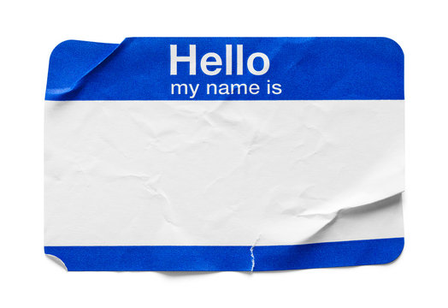
Let’s Get To Know Each Other
Please Tell Us:
Your Name
Your Experience With Agile
3 Things That Make You Happy

Slide 4

Remote Inception - Workshop Guidelines
Be Present
Limit Distractions: Teams set to Do Not Disturb, Automatic Replies switched on
Ready for your close-up
Cameras on to encourage active engagement
“Be the crew, not the passenger”
Don’t be an observer, actively participate & contribute to discussions!
Responsibility
Action Items, Key Decisions, keep Target State in mind
Open and honest conversations
Appreciate transparent conversations and voice over if you see any real concerns
Defer Judgement
All ideas are valid when brainstorming!
N.E.M.O
Needs elaboration, move on – remember the Inception principles!

Slide 5

Agile Overview

Slide 6







Waterfall Vs Agile Delivery
Requirements
Design
Implementation
WATERFALL
Verification
4
444
:
Documents
Documents
Unverified Code
Software
AGILE

Slide 7
What is the purpose of our Agile journey?
  Greater alignment with Customer and Business strategy
  Speed to Market
  Multiply Adaptability, Flexibility, and Responsiveness to change
  Increased Employee Engagement
  Leverage on Scale

Slide 8
Our Agile evolution will require new ways of working
Change management enables us to undertake the journey
From …
… To
  Bring people to the work in loosely-defined, temporary teams
  Bring the work to standing, dedicated,
  persistent teams
  Decisions through hierarchy
  Team autonomy through alignment
  Success defined by delivery of features
  Success defined by value delivered
  Big, perfect, sometimes slow
  Pace over perfection (while managing risk)
  Agile practices applied primarily to
  technical teams
  Agile beliefs and principles applied
  across Beazley
  Work aligned to projects
  Work aligned to customer value

Slide 9
Teams work in 4-week Sprints with Key Events & Activities
Events and activities for select subset of team
F
Team Leadership
D
Sprint Review & Demo
Ensure Team is achieving balance between purpose, mastery and autonomy
Briefing from
customers and other stakeholders
Share the Sprint increment and outcomes to stakeholders for feedback at the end of a Sprint in order to adapt future iterations
G
Scrum of Scrums
Gain operational alignment on cross-team dependencies
E
Retrospective
Team meeting where they reflect on processes and how to deliver better customer outcomes, faster
C
Backlog Refinement
Looking ahead to get greater clarity and prepare work that is prioritized for the next 2-3 sprints
Time-boxed
working
(4-week sprint)
Sprint Increment
Incremental release
A
Sprint Planning
Daily
Plan what work the team will do within the sprint; the Team decides how much to pull and how they will achieve the goal
Working, tested solutions created based on the Sprint plan
B
Team Stand-up
Product Backlog
Daily meeting to improve coordination through a quick check-in on progress, agreeing action plans for the day and surfacing obstacles.
Ordered list of the work that the Team may do

Slide 10
Sprint Planning
A
What is Sprint Planning?
A Scrum, Team event at the start of each sprint where the Team
plans for the work they plan on delivering during sprint
  We discuss the sprint goal and stories for this sprint
  We develop a common understanding on these stories
  We plan the stories we will deliver as a Team this sprint
Why do we have Sprint Planning?
  We want to have a plan for the work that we will deliver
  We want to come to a shared understanding of the sprint goals
  We want to build confidence in our ability to deliver on the goal
  We want to give transparency on what the Team is working on
Who participates and what are their roles?
  Agile Product Owner comes with prioritized backlog
  Full team participates in the discussion
  Team members self-organize to determine what they plan on completing during the Sprint and how they will achieve the Sprint Goal
How to conduct Sprint Planning
Backlog
  Agile Product Owner comes with prioritized backlog (incl. acceptance criteria)
  Team estimates capacity to deliver for sprint
Sprint Board
To do
Doing
Done
  Team pulls stories from backlog into "To do" column of the Sprint Board
Sprint Board
To do
Doing
Done
  Team determines who will do what to achieve the Sprint goal
Shared Understanding of Sprint Goal
Mike
Kelley
Kelley

Slide 11
Team’s Stand-up
B
What is a Team Stand-up?
The Team holds a daily stand-up every day for 15 minutes to discuss, agree, and create a firm plan for the day
  Stand-up at the same time each day; if members of the Team are in different time zones, rotate timing to accommodate
Why do we have a Team Stand-up?
  We want to create transparency into our progress
  We want to coordinate dependencies within the Team
  We want to identify anything slowing us down or preventing us from achieving our sprint goal
  We want to provide an opportunity to share issues and help each other
Who participates and what are their roles?
  Full Team participates in the discussion
  Agile Product Owner understands and aligns on next steps to remove impediments
How to conduct Team Stand-ups
Daily Round Robin
Q1: What did you accomplish yesterday that gets us closer to the Sprit Goal?
Q2: What do you plan to accomplish today that gets us closer to the Sprit Goal?
Q3: Do you have anything slowing you down or preventing progress towards achieving our Sprint Goal?
Discuss and create a firm Plan for the day

Slide 12
Backlog Refinement
C
What is Backlog Refinement?
As needed, the Team holds a session to prioritize and refine the Product Backlog and understand outcomes/objectives and stories for the upcoming 2-3 sprints
  Refining an outcome, objective or story involves three actions:
    Create a shared understanding
    Making it small enough to complete in one sprint
    Adding acceptance criteria which define when the story is complete
  Refined stories serve as an input for the next Sprint Planning
Why do we do Backlog Refinement?
  We want to ensure a common understanding of the stories on the backlog so that stories are ready to be tackled in the subsequent sprint
  We want to develop a view on what needs to be delivered 2-3 sprints ahead so that
  we are confident we can deliver the work in a timely manner
  We want to capture and distill emerging requirements and customer feedback
  We want to ensure all backlog items are truly “Ready” so that they can be pulled by the team
Who participates in the Backlog Refinement?
  Agile Product Owner and Team members clarify outcomes, objectives, and stories
  Relevant Subject Matter Experts may help answer questions and break down stories
    E.g., invite legal specialist if story has relevant legal requirements
How to conduct Backlog Refinement
Backlog
  Agile Product Owner brings stories
  Team flag ambiguities, dependencies, and work to be decomposed further
  Full team discusses and refines story narrative and acceptance criteria
Backlog
  Team updates the Product Backlog with revisions
User for Epic & Story Prioritization, Estimation & Details

Slide 13
Sprint Review & Demo
D
What is the Sprint Review & Demo?
An event at the end of each sprint in which the Team provides an update on what was planned and completed during the Sprint and demonstrates the working outcomes to stakeholder and/or customers
Why do we do a Team Demo?
  We want to celebrate our successes: outcomes and value delivered
  We want to be transparent about what we achieved, what was not, and why
  We want to collect feedback from key stakeholders and/or customers to adapt and build better products that achieve better outcomes
Who participates in the Team Demo?
  Agile Product Owner to introduce what has been completed this sprint and close with what will come next sprint
  Team members to demonstrate the outcomes
  All relevant stakeholders to ask questions and provide feedback
Example Demo formats
User testing
Solicit rapid audience feedback via
real-time demonstration
Presentations
Introduce information to an audience in a coherent story
Gallery walks
Exhibit material around a room to encourage active engagement and participation
Collaborate with Stakeholders & incorporate feedback

Slide 14
Retrospective
E
What is the Retrospective?
At the end of the sprint, the Team holds an event to reflect on last sprint and identify actions for improvement
Why do we do a Retrospective?
  We want to celebrate what we achieved and did well
  We want to discuss issues and improve our Team
  We want to empower Team members to own any changes
Who participates in the Retrospective?
  Scrum Master facilitates this event
  All Team members contribute to the discussion by recognizing accomplishments and engaging in improvement discussions
  Entire team owns the resulting action items
How to conduct a Retrospective
Team provides input on:
What went well?
What could improve?
Team discusses key areas for improvement in the next sprint
Team aligns on action items against key areas of improvement
Continuous Improvement of the Team

Slide 15
Team Leadership Meetings
F
What is the Team Leadership Forum?
A half-hour discussion that occurs once every one to two sprints:
  Align on major strategic decisions impacting the team (i.e., backlog priorities, skill requirements)
  Discuss capacity for team members to develop their skillset versus delivering outcomes
  Assess how the team is maturing on agile ways of working, across key elements of the operating model
Why do we have a Team Leadership Forum?
  We want to ensure continued partnership and between Agile Product Owner and Chapters to enable delivery on team-level outcomes
  We we want leaders to ensure continuous learning of team members, assessing performance and identifying opportunities for L&D
Who participates in the Team Leadership Forum?
  Agile Product Owner: provides insight into the demands on the team to deliver business outcomes
  Scrum Master/Agile Coach: brings perspective on teams agile performance / maturity
  Chapter Leads: ensures that teams have the skills required to deliver business outcomes, including the professional growth of individual members
How to conduct a Team Leadership Meeting
APO, CL, SM/AC, discuss progress made and future progress on:
  Business outcomes
  Skill development
  Agile maturity
  Align on business needs
  Identify skill and agile maturity development opportunities
Determine actions items to deliver business outcomes & improve team performance
To ensure the team in balancing progress against business outcomes, autonomy, and skill mastery

Slide 16
Scrum of Scrums
G
  What is the Scrum of Scrums?
  A coordination meeting between representatives of multiple Teams (often Agile Product Owners and Scrum Masters) that have many dependencies to gain operational alignment
  Why do we have a Scrum of Scrums?
  We need to create a common understanding of shared outcomes for current and upcoming sprints
  We need to align and adjust work (e.g., features and stories) to coordinate between teams that have dependencies
  Who participates in the Scrum of Scrums?
  One or more representatives from each team who can most effectively discuss the Team’s work. This is often Agile Product Owners and/or Scrum Masters
Key topics for Scrum of Scrums
Sprint Boards
  Team representative discusses progress:
  Are we aligned to deliver our outcomes this sprint?
  Is work being delivered by our dependent teams?
  Is anything slowing you down or preventing progress?
To do
Doing
Done
Sanjeev
Ilyse
John
Backlogs
  Teams align on path forward:
  What is our upcoming work and associated dependencies?
  How can we optimize our requests for support from other teams?
To ensure alignment on shared outcomes / dependencies between teams

Slide 17
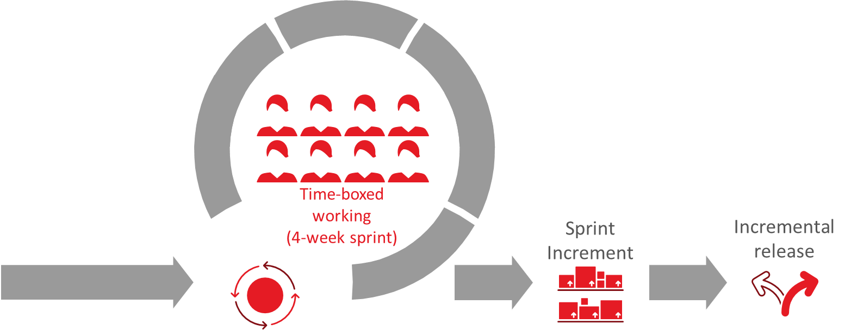
What is an Agile Sprint for Beazley
Sprint Structure
Agile sprints are a pivotal component of modern software development and project management. They represent a time-boxed, focused effort where cross-functional teams work collaboratively to deliver valuable features or enhancements as well as well as live the value of “responding to change over following a plan.”
4 Weeks Elaboration & Design
4 Weeks Build & Test

Slide 18


Sprint Structure for Release 1
Focusing on execution of current sprint while doing elaboration for next sprint
A sprint is 4 weeks in duration
Each 4 weeks duration does execution of current sprint while doing elaboration for next sprint
For Sprint 1
For Sprint 1
Last week has PREP meetings for SPRINT 3 ELABORATION
For Sprint 2
For Sprint 2
Last week has PREP meetings for SPRINT 3 ELABORATION
For Sprint 3
Last week has PREP meetings for SPRINT 3 ELABORATION

Slide 19
Key Events on a Timeline
Program Increment Cadence*
Sp1 Elab completes
Sp2 - 4 weeks Elaboration begins
Sp1 - 4 weeks Build begins
Week-4 |  |  |  |  | Week-1 |  |  |  |  | Week-2 |  |  |  |  | Week-3 |  |  |  |  | Week-4
Day-1 | Day-2 | Day-3 | Day-4 | Day-5 | Day-1 | Day-2 | Day-3 | Day-4 | Day-5 | Day-1 | Day-2 | Day-3 | Day-4 | Day-5 | Day-1 | Day-2 | Day-3 | Day-4 | Day-5 | Day-1 | Day-2 | Day-3 | Day-4 | Day-5
Sprint preparation meeting
4 hours
Sprint planning session
4 hours
Validate DoR for Build start
Sp3 - 4 weeks Elaboration begins
Sp4 - Elaboration start
Sp2 - 4 weeks Build starts
Sp3 - Build starts
Week-1 |  |  |  |  | Week-2 |  |  |  |  | Week-3 |  |  |  |  | Week-4 |  |  |  |  | Week-1
Day-1 | Day-2 | Day-3 | Day-4 | Day-5 | Day-1 | Day-2 | Day-3 | Day-4 | Day-5 | Day-1 | Day-2 | Day-3 | Day-4 | Day-5 | Day-1 | Day-2 | Day-3 | Day-4 | Day-5 | Day-1 | Day-2 | Day-3 | Day-4 | Day-5
Start Sprint in Jira
Validate sprint DoD through Jira
Sprint Jira reports & closure
Optimisation levers:
User story pushed to dev pipeline when ready
Show and tell as soon as the user story is ready
Early visibility into sprint closure through Jira dashboards
Strong focus on using Jira as single source of truth
Sprint Retrospective
(1 hour)

Slide 20
Tracking Sprint Progress
Text
Text
Text
Text
Text
Text
Text
Text
Text
Text
Text
Text
Text
Text
Text
Text
Text
Text
Text
Text
Text
Text
Text
Text
Text
Text
Text
Text
Text
Text
Text
Text
Text
Text
Text
Text
Text
Text
Text
Text
Text
Text
Text
1. Sprint Velocity by Stories
User story burn down tracking. Planned vs Actual on a daily basis
Team to take up corrective action for any lag in the burn down
Burndown charts by work streams, sprint to be configured
Text
2. Sprint Velocity by Story Points
Story points burn down tracking. Planned vs Actual on a daily basis
Team to take up corrective action for any lag in the burn down
Burndown charts by work streams, sprint to be configured
6. Test Metrics
Coverage metrics – Requirements, User story, Business process during stabilisation
Test metrics – Test execution burndown
Defect metrics – Defects by severity/priority, by work stream, over time, rejection
3. Sprint Progress
User stories progress by work stream through life cycle (dev vs test)
Reports made available via JIRA dashboards
5. Dependencies Tracking
A mechanism to be developed to track external dependencies and delays
4. Release Velocity
User story or story points burndown. Planned Vs Actual for full release
Reports made available via JIRA dashboards
Each Sprint will have a daily reporting through JIRA dashboards to track velocity numbers by story or story points and other test metrics as applicable.
The dashboard designs will be agreed between the Workstream Leads and Programme Governance teams.
Notes:
This template was inserted from Power-user, the productivity add-in for PowerPoint, Excel and Word.
Install Power-user to access thousands of templates, icons, maps, diagrams and charts with Power-user.
Visit https://www.powerusersoftwares.com/
©Power-user SAS, terms of license: https://www.powerusersoftwares.com/terms

Slide 21






Standard Agile Team Make-up
The ultimate working unit is the autonomous and empowered cross functional Agile Team chartered with specific business outcomes to advance the business strategy
Developers & Testers
Team Roles
Product Owner
Technical delivery of business solution
Spanning Functions
  Leads Team in delivering outcomes supporting
  the strategy
Agile Coach
Scrum Master
…
  Sit outside Agile construct and support teams to drive towards business outcomes
  Coaches multiple Teams on Agile principles and practices
BA
  Provides business analysis; supports requirements gathering
  Leads and reinforces Agile practices
HR
Marketing
Finance
Legal
ECX
EMR
Etc.
SMA
  Functional resource who provides ad hoc expertise and guidance
SME
  Brings expertise to provide guidance and feedback for capability development
  ~50% allocation
Engineers
  Technical delivery of business solution
UX
  Provides guidance for end user functionality and experience
Teams are measured by outcome-specific KPIs
  Business Resource
  Technical Resource

Slide 22
Backlog Construct

Slide 23



Epics, Features, Stories & Tasks
Rock Analogy:
Description:
Duration:
Worked on by:
Example:
Epic
Big chunk of work that has one common objective
Can cut across program releases
  3-5 Program
  Increments
  Account Pricing
  Circles
  The boulders
  LOB Details
  Account Level Summary Info
  Shareable Output
Feature
A service / deliverable that fulfills a stakeholder need. Can cut across sprints
  Program Increment
  The medium rocks
  1 or more Teams
  Display Rated Mod Info - WC
  View Experience Mod – WC
  What If Tool – WC
  View LOB Detail - WC
Story
A small piece of desired functionality, written in the user’s language. Must be small enough to be completed within a sprint.
  <10 days
  1-3 days avg
  The small rocks
  1 Team
Tasks
What we do to define/build/test a user story
  Hours
  Task 1
  Task 2
  Individual
  The pebbles/sand

Slide 24
Backlog Structure for Release-1 (illustrative)
Focused hierarchy to support agile delivery and sprint goals
EPIC
FEATURE
USER STORY
SPLIT USER STORIES
Ready for Sprint
Notes:
This template was inserted from Power-user, the productivity add-in for PowerPoint, Excel and Word.
Install Power-user to access thousands of templates, icons, maps, diagrams and charts with Power-user.
Visit https://www.powerusersoftwares.com/
©Power-user SAS, terms of license: https://www.powerusersoftwares.com/terms

Slide 25
Definitions
Epics
Multiple Features fit into a single Epic
Epics can cross multiple Releases
Overarching business flows which cross multiple teams and processes
Features
Multiple business flows can fit in a single feature
Complete Parent User Stories can be signed off independently to other Parent User Stories within a Feature
Features can cross multiple sprints
User Stories
Represent an independent story which may or may not have multiple Acceptance Criteria within dependent on the User Story Size
Story signed off by Product Owner against DOR and DOD criteria
User Stories should be smaller enough to complete within a single sprint, however due to technical complexities, logical dependencies or team velocity planning these may cross multiple sprints
Split User Stories
Sized so as to be achieved within a single sprint
Story sizing and necessity for splitting to be determined by BA and Technical team during elaboration and sprint planning
Typically there may be one or more development stories which will complete a single independent functional user story. The testing for the full functionality will occur in a separate test user story. All split stories will be linked to the original signed off user story to maintain traceability.
Story sign off will be on the Test Story by the PO at Sprint exit – which may be a later sprint to the original story starting sprint
Dev only stories will not be demo-ed or signed off by the PO but will count in terms of the team’s velocity and specific sprint effort

Slide 26
User Story Structure and Standards
Clear User Story standards drive quality delivery
User story structure
EPIC
User Role
User action
Business Value
Acceptance Criteria
FEATURE-1
FEATURE-2
FEATURE-N
What a user story must be
Independent
Negotiable
Valuable
Estimable
Small
Testable
US-1
US-2
US-N
US-1
US-2
US-N
USER STORY TYPEs:
A functional user story
  A story where you have a user role, action and an outcome
  Typically associated with user facing screens
  Very closely associated to the product behaviour
A technical user story
  Usually linked to a front end functional story
  Has a technical flow in the background of a functional user story
  Depends on team composition if you have separate integration team
  Applies to data and integration layer types of work
User story standards must
Follow the INVEST standard
Identify correct personas
Have a clear goal/outcome
Be explicit on pathway/flow – Given this, Then …, So that…
Meet Programme Definition of Ready

Slide 27
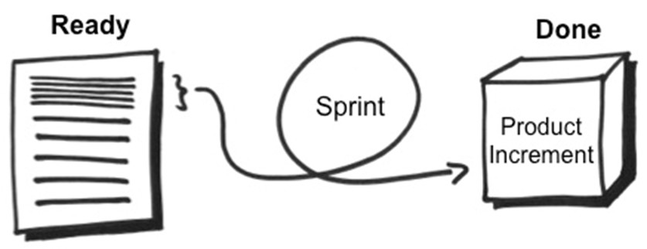
Definition of READY & Definition of DONE
The two checklists that control how the team commits & delivers work
Definition of Ready (DoR)
The criteria of a product backlog item (i.e. story of feature) has to meet before the team can start implementing it in the next sprint.
Definition of Done (DoD)
An agreement between the development team and the product owner on what needs to be completed for each product backlog item, the acceptance criteria for a sprint or release
The Definition of Done describes the target state. It must be informed by the Definition of Ready.
** Pl refer to Beazley GPAS and Billing Ways of Working presentation for more details

Slide 28
A ‘Day in a life’

Slide 29

‘A day in a life’ during Inception Workshops
Actors
Product Owner
SMEs
Solution Architect
Team members
Functional lead / BA
Inception
Accelerators / Tools
Inception
readiness
Output
Inch-deep; Mile wide
GW OOTB Feature Matrix
Decision Log, Action Item tracker
Query log
Mind map
Standards & Best Practices guide
Inception Plan
Inception session Guardrails
Right Tools – High level Backlog, Functional accelerators
Preparedness to Workshop topics
Guidewire OOTB Cloud Instance for demo
Understanding Client’s Business process at high level
As-is Process flows
Signed off Product / Release Backlog with Epic-Feature-Story mappings
Product Rationalization – definition & approach
Integration Inventory
Key Decisions, Pending Actions, Parked items Log
Future State process flows
Draft Sprint Plan
High level Designs
Architectural Decision log
Updated Dependencies Tracker
Best Practices
Focus on ‘What’ not ‘How’
Demonstrate OOTB capabilities
Leverage Workshop tools
Confine to Scope
Maximize Product Value
Think holistically (‘Big Picture’)
Bring on board all relevant Workstreams to the sessions
80:20 rule
Minimize distractions
Challenge Current Process
Be tough on Ideas, not on each other
Inception
readiness
Inception Workshops
Understand Guidewire Product Capabilities
Undergo Product Training / Product demo
Understand Ways of working, Program methodology etc
Understand Program Scope
Understanding base Architecture (e.g. Headless architecture for PolicyCenter)
Understanding UWWB Scope, capabilities and what has been built & planned
Enabling SMEs with authority to decide
Adapt Vs Adopt
1. Strategize
3. Synthesize
2. Conduct
Tasks / Ownership
Tasks / Ownership
Tasks / Ownership
Tasks / Ownership
Challenges
Architectural Solution Design
and recommendations
High level Integration Design
Data Structure & Data model
Third Party Dependencies
Context setting & Facilitate
Gather Business Requirements
Understand business need for Sys change
Demo GW Application, Process flows
Identify areas of change
Identify dependencies & impacted systems
Capture requirements;, Key decision, Actions & Parking lot items
Own and close assigned actions in time
Send Workshop minutes
Create Feature mapping to User Stories
Thinking inside of Legacy box
Trying to create Perfect Solution
Unclear Requirements
Over customization
Need Vs Want
Moderate workshops
Bring in Right participants
Make decisions quickly
Identify Owners to resolve dependencies
Own &/or Assign actions
Drive actions to closure
Ensure workshop alignment with ‘Big Picture’
Preparedness to Workshop
Active Participation
Provide Business Requirements
Elaborate Current State Process / rationale
Make decisions quickly
Own actions end to end
Close actions in time
80:20 rule
Adapt vs Adopt

Slide 30
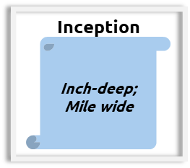
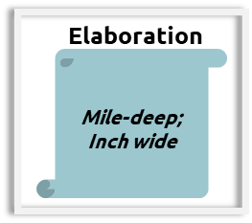
Level of requirements discussed during Inception Vs Elaboration (illustrative)
Inception Phase
Elaboration Phase
Ability to search for an Account using following fields:
First and Last name
Phone number
Postcode, Country and first/last name
Ability to search for an Account using the following fields:
First and Last Name – Alphanumeric field 20 bytes long
Phone number – 11 digits, no hyphens
Postcode, Country – should be able to handle outside UK location
Ability to search for an Account using following fields:
First and Last name
Phone number
Postcode, Country and first/last name
Ability to search for an Account using the following fields:
First and Last Name – Alphanumeric field 20 bytes long
Phone number – 11 digits, no hyphens
Postcode, Country – should be able to handle outside UK location
Ability to generate a unique policy number at the end of policy issuance process
Ability to generate a unique policy number at the end of policy issuance process
Policy Number must be 10 digital alphanumeric field
Prefix with 2 letter Country code ( E.g. – GB for United Kingdom)
Format Must be 2 letter Country code, followed by 2 letter for LOB code, followed by number 100000 for the 1st policy. Subsequently increment by 1.
Ability to have multiple Payment plans to facilitate single Payment & Installments
Ability to have 3 Payment Plan options
Full Pay with no instalments
Quarterly Plan with no Instalment fees
Monthly Plan with £5 Installment fees on every Installment Invoice
Ability to automatically Write off when Overdue amount is < £5
Ability to automatically Write-off remaining balance when
Overdue amount is < £5
Current date < 1 day before 1st Delinquency Event date

Slide 31
‘A day in a life’ during Elaboration Workshops
Actors
Product Owner
SMEs
Solution Architect
Team members
Functional lead / BA
Elaboration
Accelerators / Tools
Elaboration
readiness
Output
Mile-deep; Inch wide
Advanced Product Designer
Mind map
Feature matrix
Business rules, FLS & other templates
Decision Log, Action Item tracker, Query log
Guidewire Accelerators (e.g. Co-insurance)
Updated Sprint Plan
Elaboration session Guardrails
Right Tools – Signed-off Release Backlog from Inception, Functional accelerators
Preparedness to Workshop topics
Guidewire OOTB Cloud Instance for demo
Process during Implementation phase, Program Management Tools etc.
As-is Business Process flows
HL Future State Business Process flows from Inception
Playback sessions* to demonstrate Requirements captured
Signed-off User Stories including Business Rules, FLS and Acceptance criteria
Integration Inventory
Key Decisions, Pending Actions, Parked items Log
Updated Future State process flows
Low level Designs
Architectural Decision log
Updated Dependencies Tracker
Updated RAID log
User Stories handed over to Dev & Test teams
Best Practices
Maximize Product Value
Demonstrate OOTB capabilities
Use wireframes or mock-ups
Leverage Workshop tools
Storyboarding
Build incrementally
Think holistically (‘Big Picture’)
Bring on board all relevant Workstreams to the sessions
80:20 rule
One Team approach
Seamless communication
Follow Agile Ceremonies
Elaboration
readiness
Elaboration Workshops
Understand Guidewire Product Capabilities
Deep-dive into Ways of working, Program methodology for Implementation phase
Understand Release Scope
Understanding base Architecture (e.g. Headless architecture for PolicyCenter)
Understanding UWWB Scope, capabilities and what has been built & planned
Enabling SMEs with authority to decide
Adapt Vs Adopt
1. Strategize
3. Synthesize
2. Conduct
Tasks / Ownership
Tasks / Ownership
Tasks / Ownership
Tasks / Ownership
Challenges
Architectural design and decisions
Low level Designs
Integration approach
Migration Strategy
Data mart or Data lake designs
Third Party Dependencies
Other Tooling required
Facilitate & Deep-dive into Business Requirements
Understand detailed business process
Demonstrate OOTB functionality
Identify areas of system change
Identify dependencies & impacted systems
Capture requirements;, Key decision, Actions & Parking lot items
Own and close assigned actions in time
Capture workshop notes, detailed requirements & failover conditions
Scope change on signed-off requirements
Thinking inside of Legacy box
Trying to create Perfect Solution
Over customization
Procrastination & indecisive
Moderate workshops
Bring in Right participants
Make decisions quikcly
Encourage SMEs to make decisions
Identify action Owners & resolve dependencies
Own &/or Assign actions
Drive actions to closure
Ensure workshop alignment with ‘Big Picture’
Preparedness to Workshop
Active Participation
Provide detailed Business Requirements
Elaborate Current State Process / rationale
Make decisions quickly
Own actions end to end
Close actions in time
80:20 rule
Adapt vs Adopt

Slide 32
‘A day in a life’ during Elaboration Playback sessions*
Accelerators / Tools
Requirements gathered
Mockups
Data model changes
Business rules, FLS & other templates
Actions & resolutions
Functional lead / BA to replay all the User Story requirements gathered from the Workshops
Capture/ incorporate feedback on the played-back requirements
Walkthrough Screen mockup & data model changes, Business rules, Activities and Audit trail forming part of the User Story
User Story or Requirements document updated based on SME/PO feedback to existing requirements
Best Practices
Capture any pending actions, parked items & impacts therefor to the current User Story/Sprint
Any new or changes to existing requirements gathered to be taken-away for assessment & plan of action
Bring all the required Stakeholders into the room
Ring fence Playback Scope to relevant User Stories & requirements
Lead-support roleplay
Avoid any new requirements or changes to current requirements captured
Capture & incorporate feedback online to the Pack
Capture any new risks, dependencies or issues raised to action offline
Repeat the exercise for all the Requirements/User Stories
Capture and circulate the minutes from Playback-session
SMEs and Product Owner to validate and agree on every US requirements presented
The User Stories accepted during the play-back will be shared with PO for sign-off
Challenges
Actors
Product Owner
SMEs
Solution Architect
Team members
Functional Lead / BAs
Test teams
Not having the right participants in the room delays the process
Missing the big picture
Trying to create Perfect Solution
Procrastination & indecisive

